Slide 1
STRESS MANAGEMENT

Slide 2
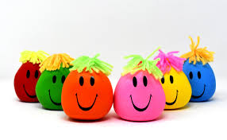
Let’s manage stress….

Slide 3
What is stress???
Stress is body’s response to any change in an individual’s life.
Stress happens when our requirements exceeds our available resources.

Slide 4
Causes of stress
Exams
Meeting the deadlines
Peer pressure
Difficulty in organizing task
Poor time management
Leaving task to the last minute
Unrealistic expectations
Finance
Relationships
Past experiences

Slide 5
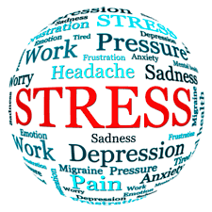

Slide 6
Symptoms of stress
Excess of sweating,
Headaches,
Sleeplessness,
Lack of hunger,
Lack of concentration,
Low performance,
Anxiety

Slide 7
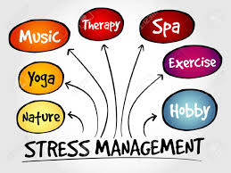

Slide 8
Stress management techniques
Avoid or alter the situation
Adapt to situation
Accept the situation

Slide 9
Avoid or alter the situation
Learn to say “NO”
Avoid people who creates stress
Prepare a to do list
Express your feelings
Manage your time

Slide 10
Time management
Urgent
Not Urgent
I | II
III | IV
Important
Not Important

Slide 11
Adapt to situation
Positive attitude
ABC technique
Adjust your standards

Slide 12
ABC Technique
ABC stands for:
Adversity.
Beliefs.
Consequences.
How we think about this creates Beliefs. These beliefs then influence what we do next, so they become Consequences.
Here's an example – you yell at your friend because she forgot to print a key report before your submission (Adversity). You then think, "I'm a really lousy, I should have done it" (Belief). You then perform poorly during your presentation, because your self confidence has plummeted (Consequences)

Slide 13
Accept your situation
Exercise
Yoga and meditation
Proper sleep
Don’t try to control the uncontrollable
Learn to forgive

Slide 14
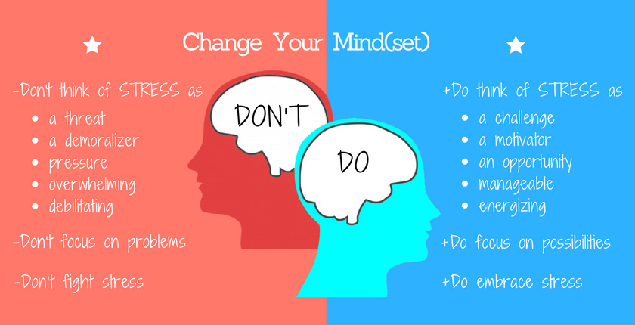
Stress is not always negative
A moderate amount of stress helps , as it:
Increases performance
Enhances concentration
Keeps us going

Slide 15
“It’s not stress that kills us, it is our reaction to it” –Hans Selye

